Slide 1



SharePoint Development PnP Reusable Controls and PnPJS Joel Rodrigues Development Consultant Corporate Project Solutions
@JoelFMRodrigues
https://joelfmrodrigues.wordpress.com

Slide 2
Agenda
Reusable controls (React)
Reusable property pane controls (React)
PnPJS library
Demo

Slide 3
Reusable controls
Reusable React controls for SharePoint Framework solutions

Slide 4
Reusable controls
Common project requirements
Use Office UI Fabric
Rich user experience
Used in pages (content)
Very simple to configure and use
Extensible events
Open source
“SharePoint-aware”

Slide 5
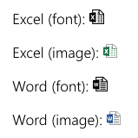
FileTypeIcon
Returns the file type icon based on a specified file path or application.

Slide 6
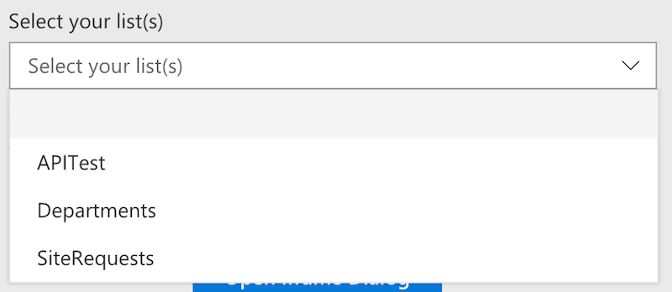
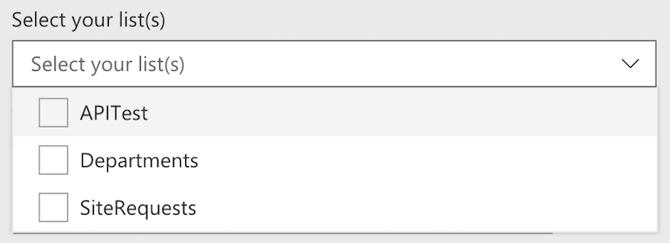
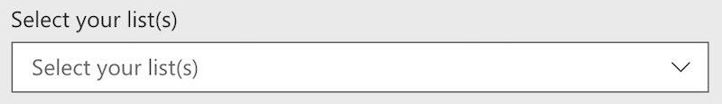
ListPicker
Allows you to select one or multiple available lists/libraries of the current site.

Slide 7
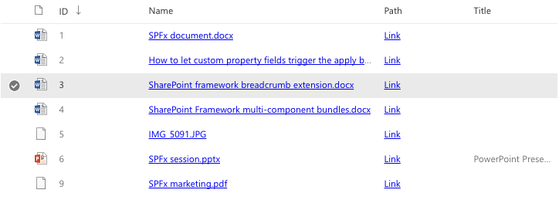
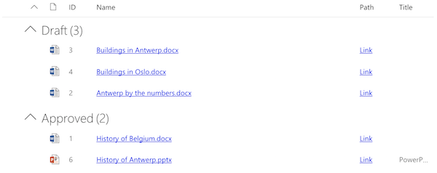
ListView
Renders a list view for the given set of items.

Slide 8
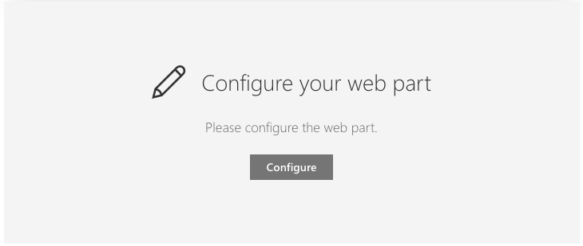
Placeholder
Renders a placeholder which can be used to show a message indicating the web part still has to be configured.

Slide 9


SiteBreadcrumb
Returns a breadcrumb based on the current location.

Slide 10
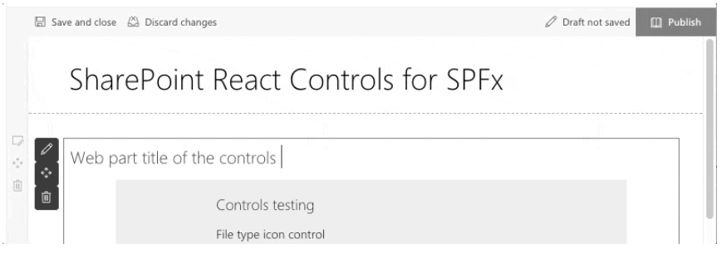
WebPartTitle
Renders a web part title that is editable when the page is in edit mode.

Slide 11
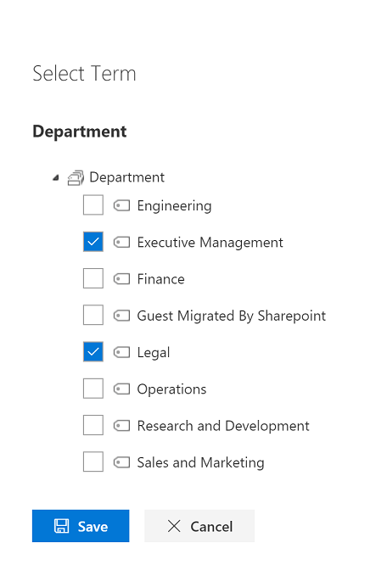
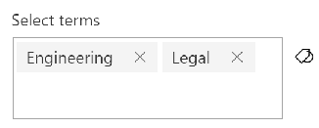
TaxonomyPicker
Allows you to select one or more Terms from a TermSet via its name or TermSet ID.

Slide 12
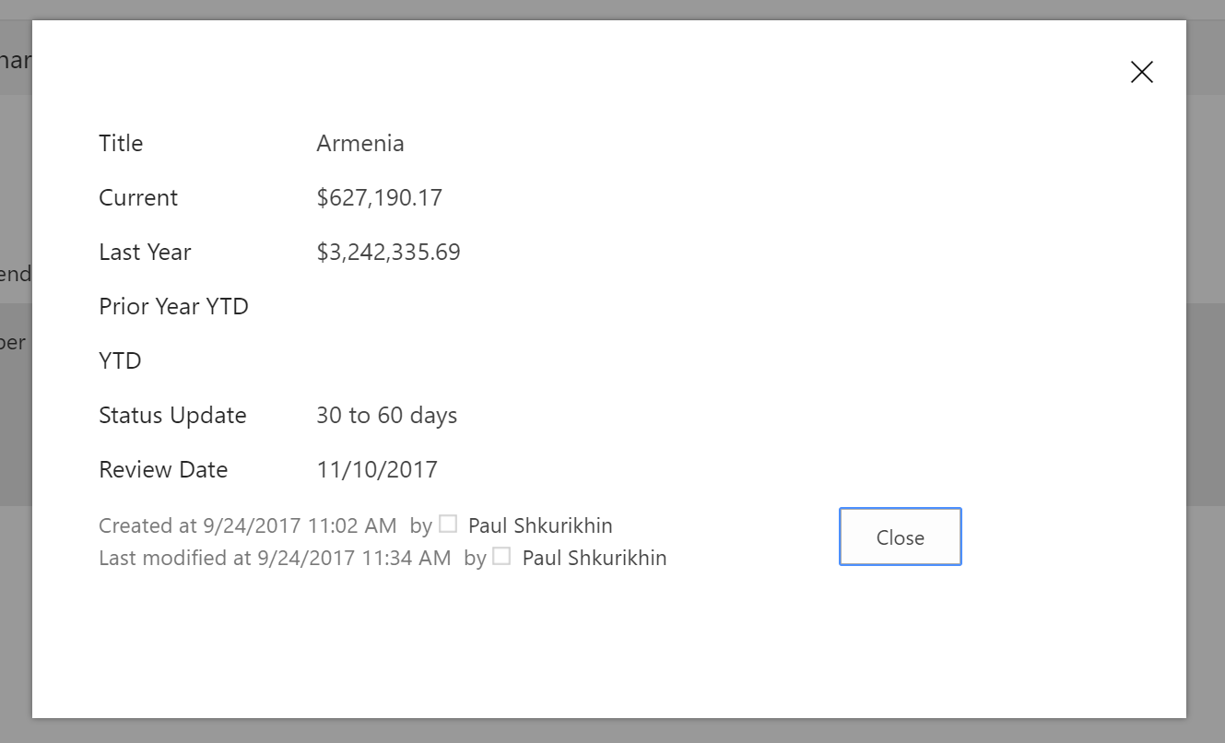
IFrameDialog
Renders a Dialog with an iframe as content.

Slide 13
Field Controls
“React controls that can be used in SPFx Field Customizers to provide rendering of the fields similar to out of the box experience.”
FieldAttachmentsRenderer
FieldDateRenderer
FieldFileTypeRenderer
FieldLookupRenderer
FieldNameRenderer
FieldTaxonomyRenderer
FieldTextRenderer
FieldTitleRenderer
FieldUrlRenderer
FieldUserRenderer

Slide 14
Reusable property pane controls
Reusable property pane controls for SharePoint Framework solutions

Slide 15
Reusable property-pane controls
Common project requirements
Use Office UI Fabric
Rich user experience
Used in web part property-pane
“SharePoint-aware”
Very simple to configure and use
Extensible events
Open source

Slide 16
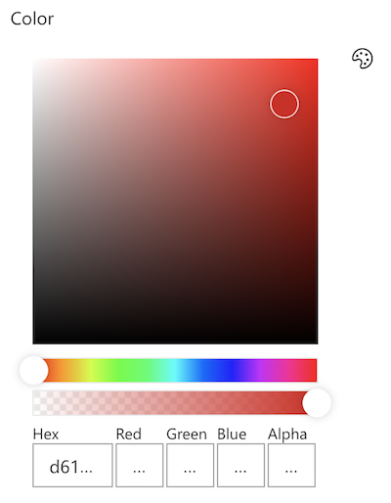
PropertyFieldColorPicker
Generates a color picker that you can use inside the property pane.

Slide 17
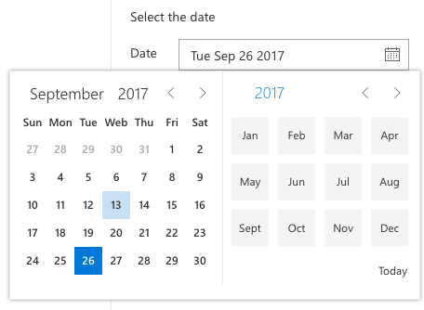
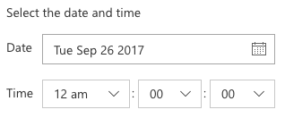

PropertyFieldDateTimePicker
Generates a Date and Time picker field that can be used in the property pane of your SharePoint Framework web parts.
The control can be configured to be date only or date and time.

Slide 18
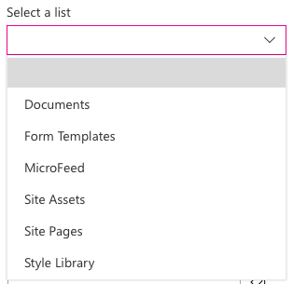
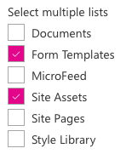
PropertyFieldListPicker
Generates a list picker field that can be used in the property pane of your SharePoint Framework web parts.
The control can be configured as a single or multi-selection list picker.

Slide 19
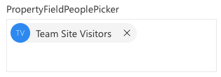
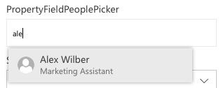
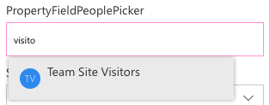
PropertyFieldPeoplePicker
Generates a people / group picker that can be used in the property pane of your SharePoint Framework web parts.

Slide 20


PropertyFieldSpinButton
Generates a spin button which allows the user to incrementally adjust a value in small steps.

Slide 21
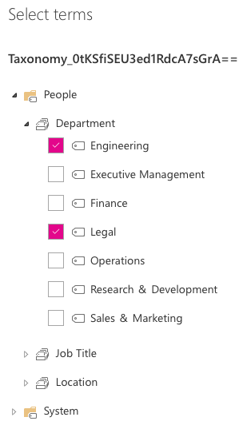

PropertyFieldTermPicker
Generates a term picker that can be used in the property pane of your SharePoint Framework web parts.

Slide 22
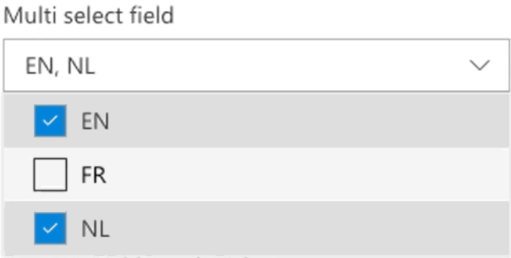
PropertyFieldMultiSelect
Generates a dropdown with the possibility of selecting multiple values.

Slide 23
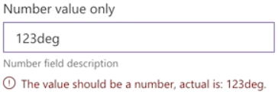
PropertyFieldNumber
Generates an input field for numbers. Text is not allowed as this will result into an invalid input.

Slide 24
Controls with callout
Standard controls with callout for displaying additional contextual information
PropertyFieldButtonWithCallout
PropertyFieldCheckboxWithCallout
PropertyFieldChoiceGroupWithCallout
PropertyFieldDropDownWithCallout
PropertyFieldLabelWithCallout
PropertyFieldLinkWithCallout
PropertyFieldSliderWithCallout
PropertyFieldTextWithCallout
PropertyFieldToggleWithCallout

Slide 25
PnPJS
Fluent JavaScript API for consuming SharePoint and Office 365 REST APIs

Slide 26
PnPJS
Fluent API
SharePoint and Office 365 REST APIs
Type-safe
Very simple to configure and use
Removes the complexity of some operations
Easy to batch requests
Multiple packages, only install what’s required
SharePoint Framework, Node.js, or JavaScript projects
Open source

Slide 27
Packages - @pnp/
common
Provides shared functionality across all pnp libraries
config-store
Provides a way to manage configuration within your application
graph
Provides a fluent api for working with Microsoft Graph
logging
Light-weight, subscribable logging framework
nodejs
Provides functionality enabling the @pnp libraries within nodejs
odata
Provides shared odata functionality and base classes
pnpjs
Rollup library of core functionality (mimics sp-pnp-js)
sp
Provides a fluent api for working with SharePoint REST
sp-addinhelpers
Provides functionality for working within SharePoint add-ins

Slide 28

Demo
Web part to list documents from a SharePoint document library
The web part should be configurable to allow the user to
select the source list from the site
Select a managed metadata term to use as filter
List, managed metadata and sample data already available on a test site
Source code:
https://github.com/joelfmrodrigues/demos/tree/master/PnP%20Controls

Slide 29
Resources
Reusable controls (React)
https://github.com/SharePoint/sp-dev-fx-controls-react
https://sharepoint.github.io/sp-dev-fx-controls-react/
Reusable property pane controls (React)
https://github.com/SharePoint/sp-dev-fx-property-controls
https://sharepoint.github.io/sp-dev-fx-property-controls/
PnPJS
https://github.com/pnp/pnp
https://pnp.github.io/pnp/
Web Part samples
https://github.com/SharePoint/sp-dev-fx-webparts
Extension samples
https://github.com/SharePoint/sp-dev-fx-extensions

Slide 30
Thank You! Questions? Joel Rodrigues Development Consultant Corporate Project Solutions
@JoelFMRodrigues
https://joelfmrodrigues.wordpress.com

